Slide 1
IMPROVING CLINICAL DECISION SUPPORT SYSTEM THROUGH PATIENT CASE SIMILARITY
PIP104 PROFESSIONAL PRACTICE-II
VIVA-VOCE
Batch Number: CAI G - 13
Roll Number | Student Name
20201CAI0088 | D L SIRI
20201CAI0095 | CHARITHA K
20201CAI0099 | PRAMOD K
20201CAI0142 | VARSHA K
Under the Supervision of,
Dr. Komalavalli C
Professor
School of Computer Science & Engineering
Presidency University

Slide 2
Introduction
The evolution of healthcare systems has witnessed a paradigm shift with the integration of cutting-edge technologies, particularly in the domain of diagnosis and disease prediction. This paper introduces a Smart Healthcare System that harnesses the power of four machine learning models - Naive Bayes, Random Forest, Decision Tree, and Support Vector Machine (SVM) - to diagnose symptoms and predict diseases. By leveraging diverse algorithms, the system aims to enhance the accuracy and robustness of healthcare decision-making.
The proposed system begins by collecting patient symptom data, which is then pre-processed to ensure high-quality input for the machine learning models. Naive Bayes, Random Forest, Decision Tree, and SVM are employed as the primary diagnostic and predictive engines, each offering unique strengths in processing healthcare data. These models are trained on large, diverse datasets to enhance their performance and generalization capabilities.

Slide 3
Literature Review
SL.NO | Authors | Year of publication | Title | Drawbacks | Journal
1 | Jenna Wiens Erica S Shenoy | 2017 | Machine Learning for healthcare : On Verge of a Major shift in Healthcare Delivery | Lack specific details on the implementation and real-world impact of machine learning models. | National Library of Medicine
2 | K Shailaja B Seetharamulu M A Jabbar | 2018 | Machine Learning in Healthcare | A potential lack of emphasis on emerging trends or novel approaches in healthcare. | IEEE Xplore
3 | Huirui Han Mengxing Huang Yu Zhang Jing Liu | 2018 | Decision Support System for Medical Diagnosis Utilizing Imbalanced Clinical Data | Class imbalance is a issue for multi label learning approach. | MDPI
4 | Christopher Toh James P Brody | 2021 | Applications of Machine Learning in Healthcare | Does not specify the range of applications covered, potentially limiting the scope. | Chapter Metrics Overview

Slide 4
Research Gaps Identified
The existing methods and technologies used in the development of a Smart Healthcare System for symptom diagnosis and disease prediction may vary, but we can provide a general overview of common approaches and technologies that are typically employed in this context:
Electronic Health Records (EHRs)
Clinical Decision Support Systems (CDSS)
Machine Learning Models
Data Preprocessing
Telemedicine and Wearable Devices

Slide 5
Proposed Methodology
Machine Learning Models: Utilizing four different machine learning models - Naive Bayes, Random Forest, Decision Tree, and Support Vector Machine (SVM) - to diagnose symptoms and predict diseases. This multi-model approach aims to enhance the accuracy and robustness of healthcare decision-making.
Voice Assistant Powered by OpenAI: Incorporating OpenAI's voice assistant technology to enable voice interactions with the system. This can enhance user accessibility and convenience, allowing users to interact with the healthcare system using natural language commands and queries.

Slide 6

SUSTAINABLE DEVLOPMENT GOALS

Slide 7
SUSTAINABLE DEVLOPMENT GOALS
Our project Title goes with SDG 3: Good Health & Well-being
Targets:
Reduce maternal & child mortality
Ensure universal health coverage
Address diseases (HIV/AIDS, TB, malaria)
Promote mental health & combat substance abuse
Strengthen health infrastructure
Aim: Achieve healthy lives & well-being for all by 2030 through accessible, quality healthcare, addressing health risks, and enhancing mental well-being.
Significance: Recognizes health's crucial role in sustainable development, emphasizing holistic healthcare considering social, economic, and environmental factors.

Slide 8
Objectives
Develop a Multi-Model Healthcare System
Optimize Diagnostic Accuracy
Enhance Disease Prediction
Ensure Data Privacy and Security
Evaluate Model Performance
Integrate Real-Time Data
Improve Decision Support
Cost-Effective Healthcare
Patient Engagement and Empowerment

Slide 9
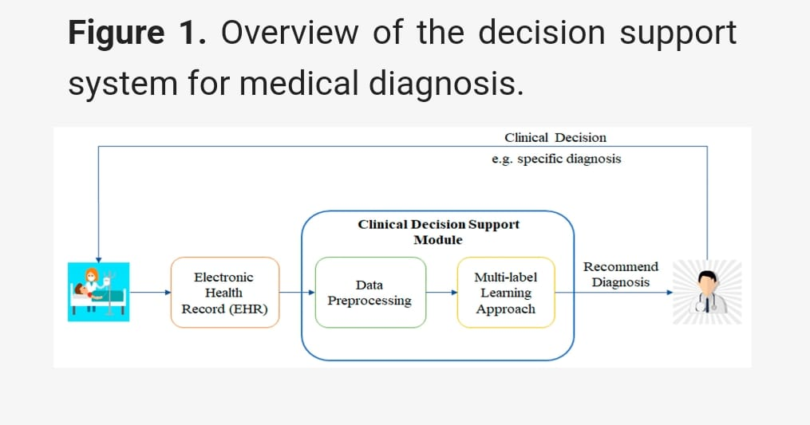
System Design & Implementation

Slide 10
System Design & Implementation
Import Libraries:
import pandas as pd
import numpy as np
import matplotlib.pyplot as plt
import seaborn as sns
Read Dataset:
df_train = pd.read_csv('Training.csv')
df_train.head()
df_train.describe() # statistical analysis of the data
df_train['prognosis'].value_counts() # as we can see that all the classes are balanced

Slide 11
System Design & Implementation
Spliting the Dataset and training the model:
y=df_train['prognosis'] #target
x=df_train.drop(['prognosis'],axis=1) #symptoms
x_train,x_test,y_train,y_test=train_test_split(x,y,test_size=.33,random_state=42)
Evaluate Model:
print("Actual score on test data")
print("Random Forest",clf_rf.score(m,n))
print("Decision Tree",clf_dt.score(m,n))
print("Naive Bayes",clf_nb.score(m,n))
print("Support Vector Machine",clf_svm.score(m,n))

Slide 12
System Design & Implementation
Predicting the disease:
def Predict_disease(symptoms):
if len(symptoms) > 1:
# Create empty dataframe to hold symptoms
symptoms_df = pd.DataFrame(columns=x_train.columns)
# Add input symptoms to dataframe
symptoms_df.loc[0] = 0
for symptom in symptoms:
symptoms_df[symptom] = 1
# Make prediction using trained model
pred = rf.predict(symptoms_df)
return pred[0]
else:
return symptoms[0]

Slide 13
System Design & Implementation
def main():
st.title("Disease Predictor")
# Take input of the Patient Details
first_name = st.text_input("Enter First Name:")
last_name = st.text_input("Enter Last Name:")
phone_number = st.text_input("Enter Phone Number:")
selected_date = st.date_input("Select the Date:")
st.sidebar.header("Symptoms")
options = train.drop('prognosis', axis=1).columns.tolist()
symptoms = st.sidebar.multiselect("Select symptoms", options)
if st.sidebar.button("Predict"):
if symptoms and first_name and last_name and phone_number and selected_date:

Slide 14
System Design & Implementation
# Display input data
st.subheader("Patient Information and Symptoms:")
st.text(f"First Name: {first_name}")
st.text(f"Last Name: {last_name}")
st.text(f"Phone Number: {phone_number}")
st.text(f"Selected Date: {selected_date}")
st.text(f"Symptoms: {', '.join(symptoms)}")
predicted_disease = Predict_disease(symptoms)
st.success(f"Predicted Disease:\t{predicted_disease}")
speak_text(predicted_disease)

Slide 15
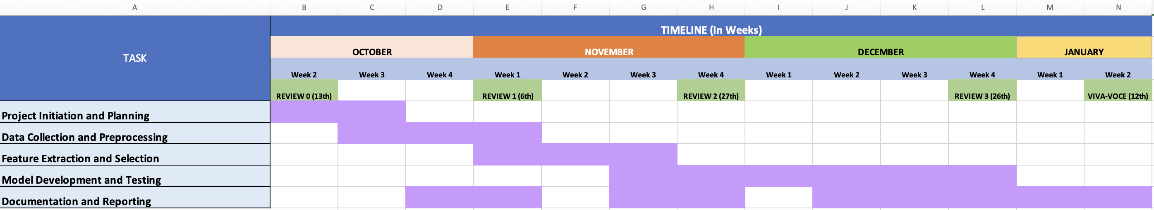
Timeline of Project

Slide 16
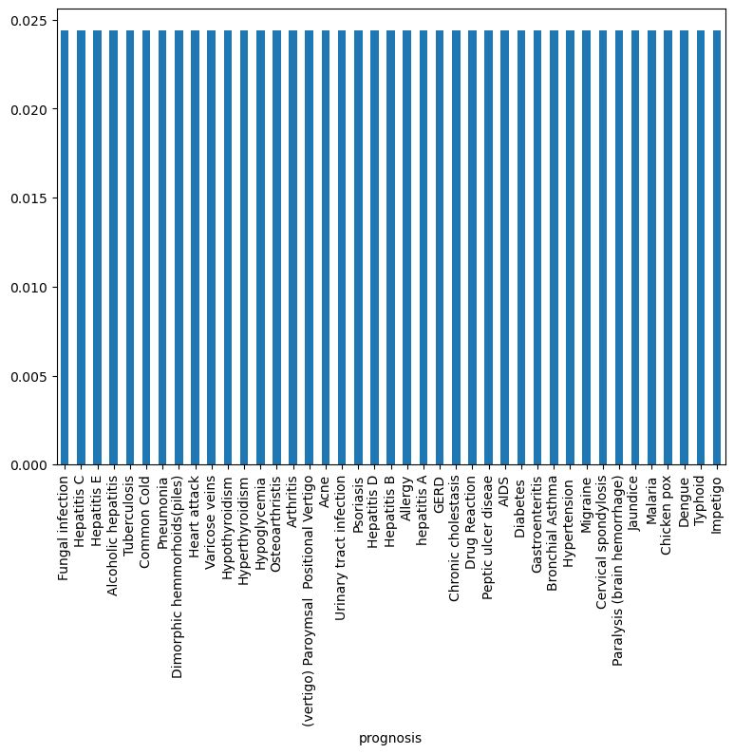
Outcomes
Graphical Representation of Balanced dataset:

Slide 17
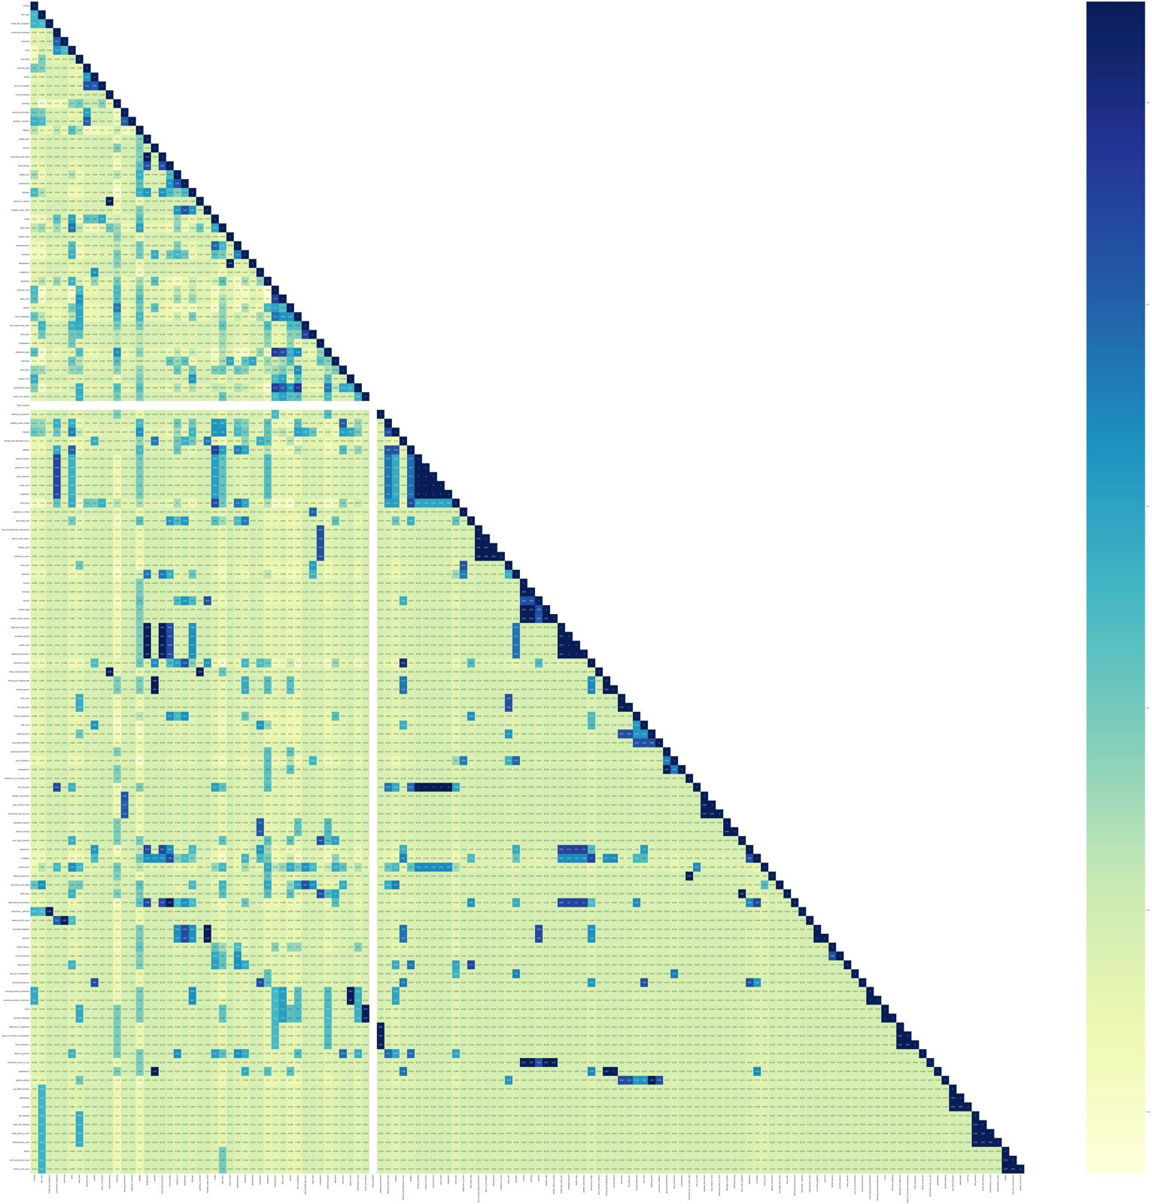
Outcomes
Correlation

Slide 18
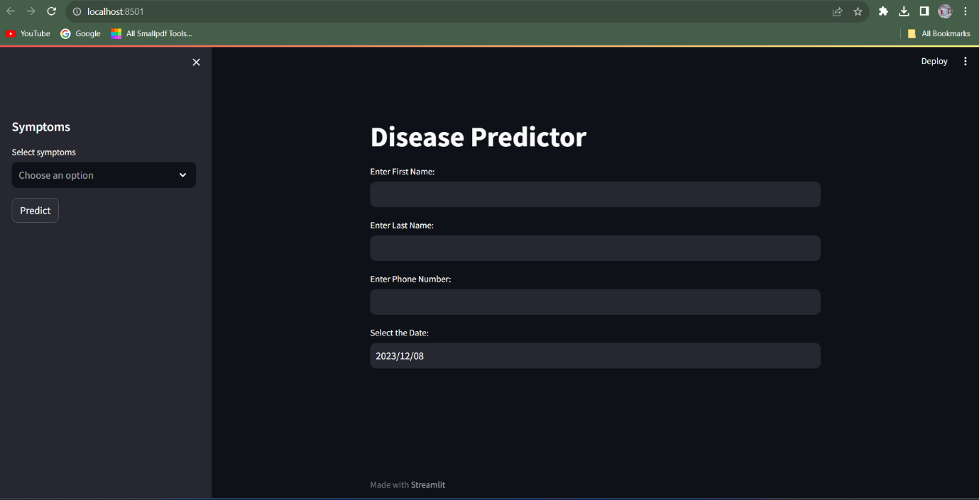
Outcomes / Results Obtained
Web Application

Slide 19
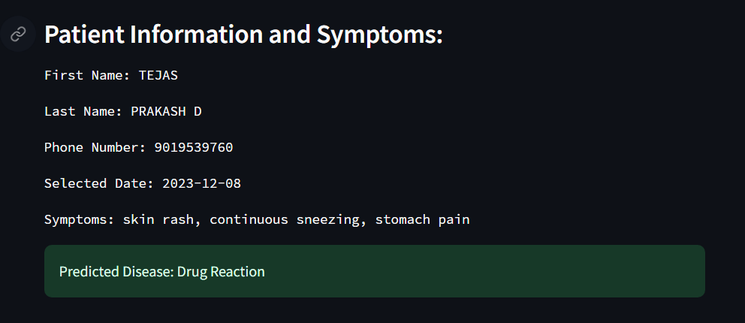
Outcomes
Web Application

Slide 20
Conclusion
In conclusion, the development of a Smart Healthcare System that integrates machine learning models for symptom diagnosis and disease prediction, along with voice interaction capabilities using OpenAI, represents a significant advancement in the healthcare sector. This system has the potential to revolutionize healthcare delivery by enhancing diagnostic accuracy, patient engagement, and overall healthcare outcomes.
By leveraging multiple machine learning models, including Naive Bayes, Random Forest, Decision Tree, and Support Vector Machine, the system aims to provide more accurate and robust symptom diagnosis and disease prediction. The inclusion of voice interaction through OpenAI offers greater accessibility and convenience, making it easier for healthcare professionals and patients to interact with the system.

Slide 21
References
Davenport, T. H., & Kalakota, R. (2019). The potential for artificial intelligence in healthcare. Future Healthcare Journal, 6(2), 94-98.
Rajkomar, A., Dean, J., & Kohane, I. (2019). Machine learning in medicine. The New England Journal of Medicine, 380(14), 1347-1358.
Obermeyer, Z., & Emanuel, E. J. (2016). Predicting the future—big data, machine learning, and clinical medicine. The New England Journal of Medicine, 375(13), 1216-1219.
Esteva, A., Robicquet, A., Ramsundar, B., Kuleshov, V., DePristo, M., Chou, K., ... & Dean, J. (2019). A guide to deep learning in healthcare. Nature Medicine, 25(1), 24-29.
Gulshan, V., Peng, L., Coram, M., Stumpe, M. C., Wu, D., Narayanaswamy, A., ... & Webster, D. R. (2016). Development and validation of a deep learning algorithm for detection of diabetic retinopathy in retinal fundus photographs. JAMA, 316(22), 2402-2410.

Slide 22
Publication Details
About IJCRT : Scholarly open access journals, Peer-reviewed, and Refereed Journals, Impact
factor 7.97 (Calculate by google scholar and Semantic Scholar | AI-Powered
Research Tool) , Multidisciplinary, Monthly, Indexing in all major database &
Metadata, Citation Generator, Digital Object Identifier(DOI) | UGC Approved
Journal No: 49023 (18)
Paper ID : IJCRT2312749
Title of Paper : Improving Clinical Decision Support through Patient Case Similarity
Impact Factor : 7.97 (Calculate by Google Scholar) | License by Creative Common 3.0
Publication Date : 17-December-2023
Published in : Volume 11 | Issue 12 | December 2023
Page No : g680-g685
Published URL : http://www.ijcrt.org/viewfull.php?&p_id=IJCRT2312749
Authors : D L SIRI, Charitha K, Varsha K, Pramod Krishnachari, Dr C Komalavalli

Slide 23

Thank You

